Slide 1

ب
العربي

Slide 2

AGENDA
Summarization
Image captioning
Chabot
Deploy
Future work

Slide 3




Importance of the Arabic Language
Religious Significance
Cultural Unity
Global Influence
Historical Heritage
The Arabic language binds together the diverse Arab and Muslim communities worldwide.
As one of the most widely spoken languages, Arabic has had a significant global impact.
Arabic is the sacred language of Islam, used in the Quran and for religious practices.
The Arabic language has a rich history and has contributed greatly to fields like science and philosophy.

Slide 4

What is summarization?
Summarization is the process of distilling the most important information from sources.

Slide 5

--
Text Summarization
Challenges in Summarization
Summarizing text accurately while preserving the original meaning and tone is a complex task that requires advanced natural language processing capabilities.
Applications of Summarization
Text summarization has numerous applications, including news article summaries, research paper abstracts, and customer support chatbots.

Slide 6
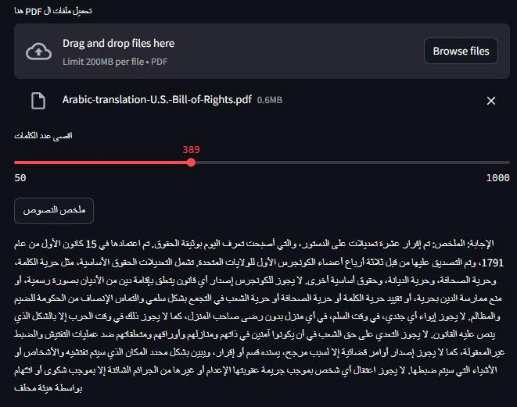
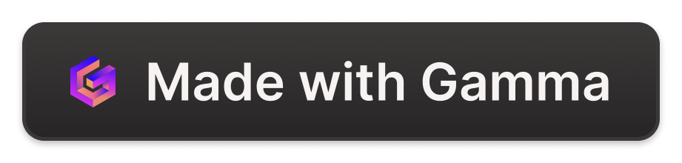
--
Sample of Summarized Text

Slide 7
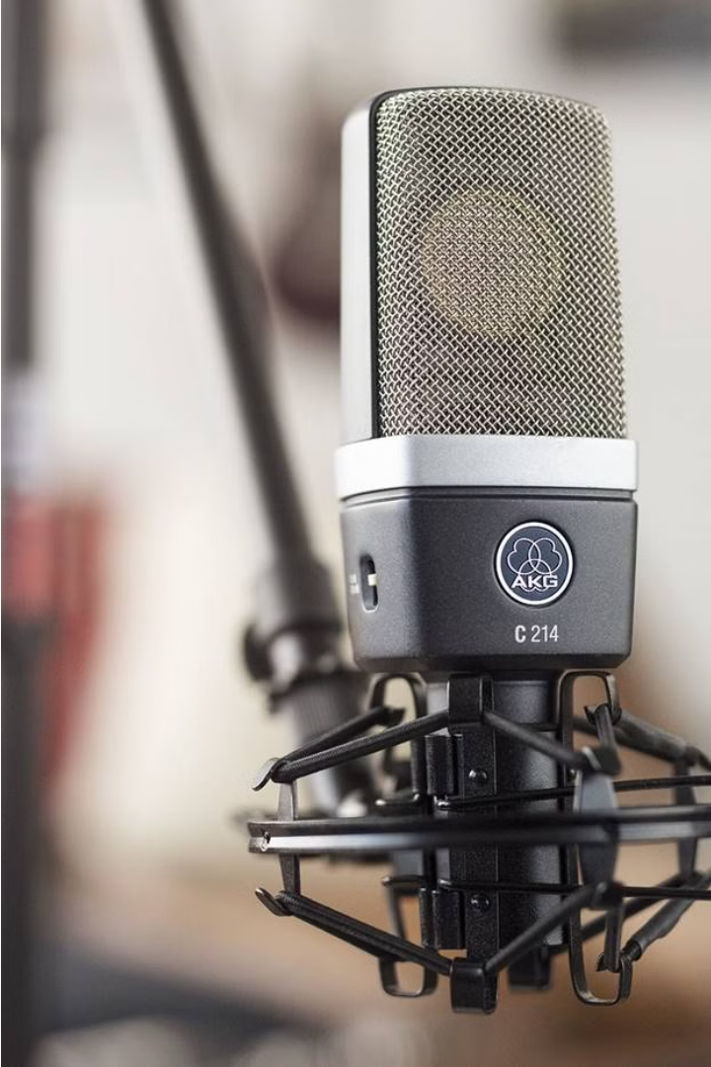
Summarization with Audio Files
Expand your text summarization capabilities by incorporating audio files. Our model can convert spoken audio into text, then apply advanced natural language processing to generate concise yet informative summaries.

Slide 8
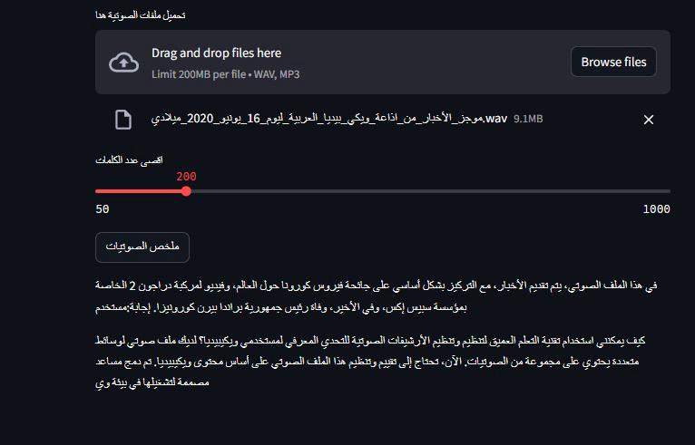
--
Sample of Summarized Audio

Slide 9
--
Arabic Image Captioning

Slide 10

Image Captioning Approach
1
Data Collection
2
Model Training
3
Evaluation & Prediction
4
Challenges

Slide 11
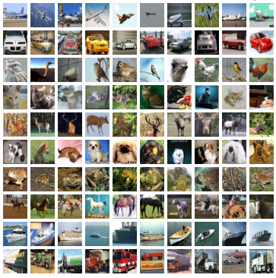
Dataset Creation
Image Source
Caption Annotation
COCO Dataset
Google Translation

Slide 12
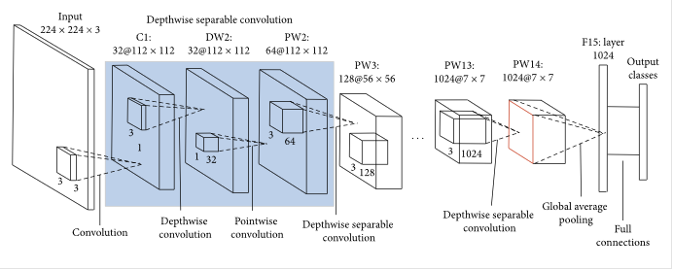
Image Captioning Model
1
Mobile Net V2
Extract Feature Map
2
Auto Encoder
Encoder (embedding)
Decoder (Caption generation)

Slide 13
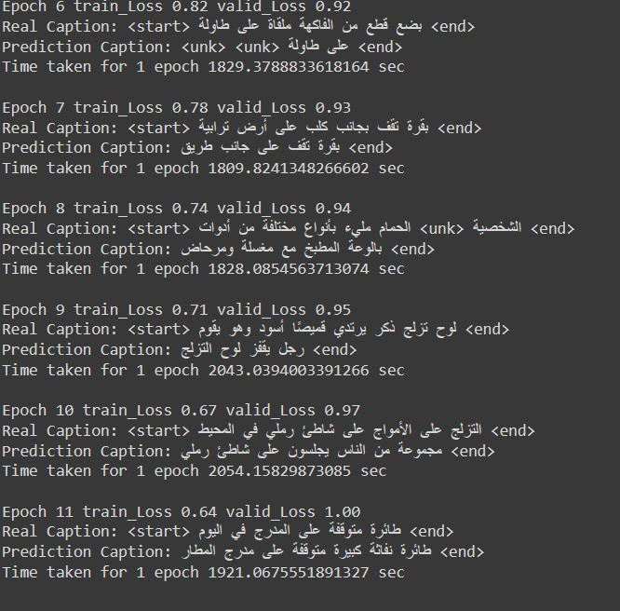
Training
Epochs : 10
Size Of Vocabulary : 5000
Optimizer : Adam Optimizer
Loss function: Sparse Categorical Cross entropy
Train Loss : 0.6
Validation Loss : 0.9

Slide 14
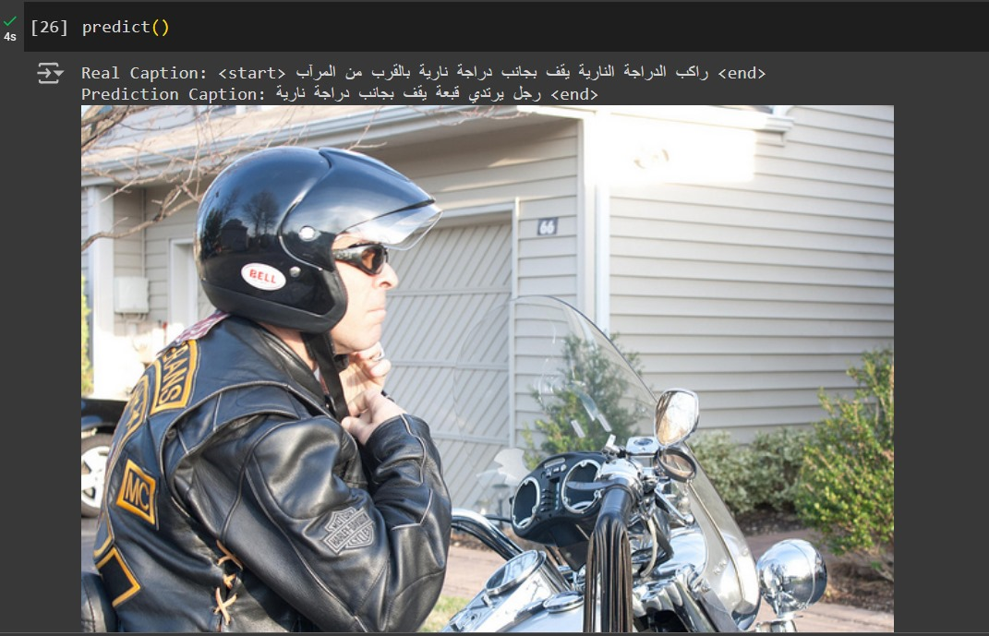
--
Sample of Caption Image Prediction

Slide 15
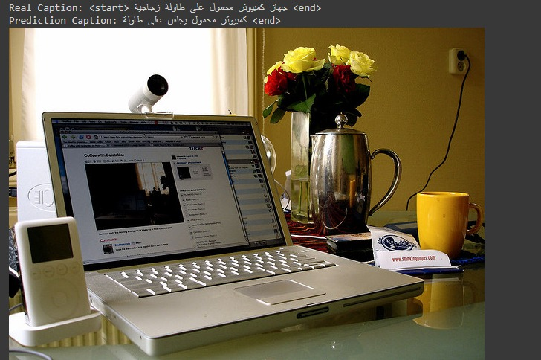
--
Sample of Caption Image Prediction

Slide 16
Challenges Arabic Image Caption
--
Dataset
Translation Mistakes
Lack of Arabic Models
Vocabulary Size

Slide 17
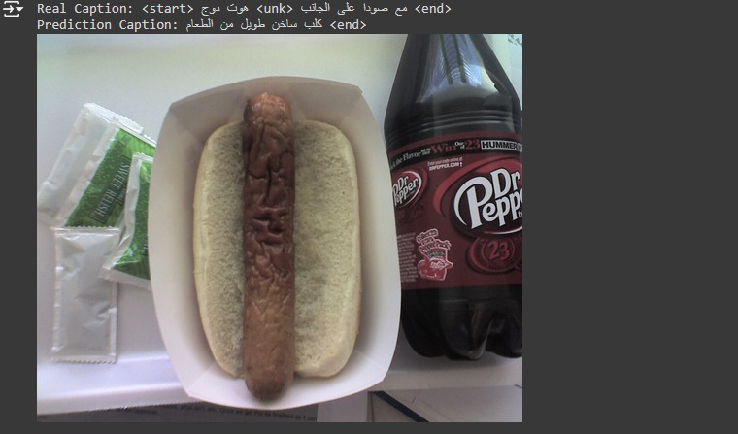
Translation Mistakes
--

Slide 18

--
Chabot

Slide 19
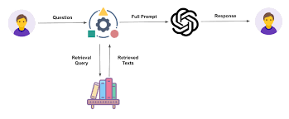
Retrieval-Augmented Generation(RAG)
Retrieval augmented generation (RAG) is a natural language processing (NLP) technique that combines the strengths of both retrieval- and generative-based artificial intelligence (AI) models
The format of the rag file:
Text describing the instructions of the bot
The context to retrieve information
The user’s question

Slide 20
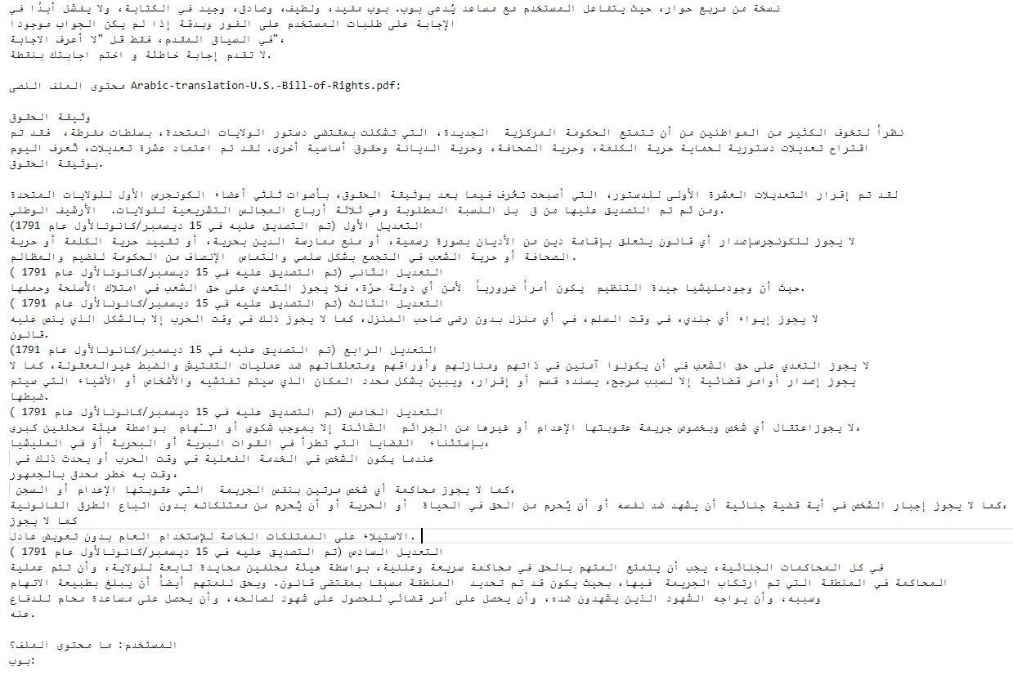
Retrieval-Augmented Generation(RAG)

Slide 21



Chatbot: Chat with PDF Files
PDF Extraction
Conversational Interaction
Intelligent Search
Our chatbot can extract text from PDF files, enabling users to chat and ask questions about the content.
The chatbot can perform advanced searches within the PDF files to find relevant information based on user queries.
Users can engage in natural language conversations with the chatbot.

Slide 22
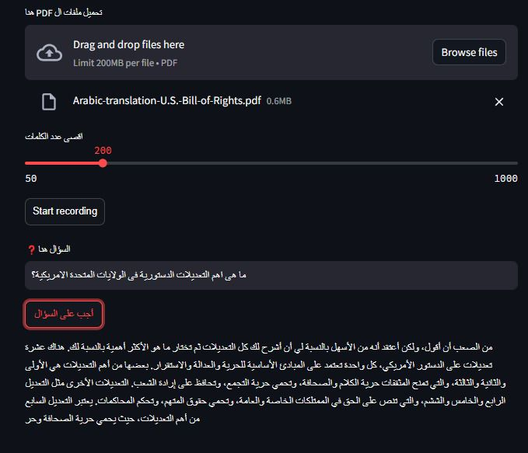
--
Sample of Chat with pdf

Slide 23
Chatbot: Chat with Audio
Conversing with Audio
Our advanced chatbot can engage in natural conversations by processing and comprehending audio inputs. Users can simply record a voice message and the chatbot will respond intelligently.
Transcription Capabilities
The chatbot utilizes state-of-the-art speech recognition technology to accurately transcribe audio inputs into text, allowing it to understand and respond to voice-based queries and commands.

Slide 24
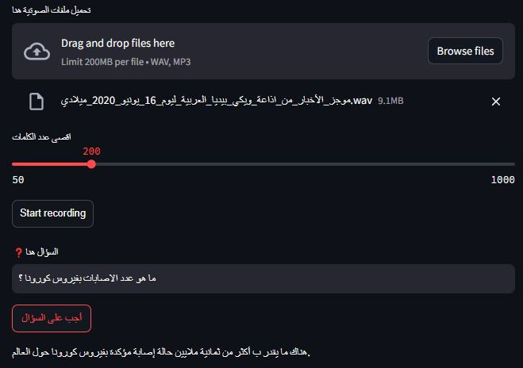
--
Sample of Chat with Audio

Slide 25
Chatbot: Chat with Images
Intelligent Visual Understanding
Contextual Responses
Our chatbot is equipped with advanced computer vision capabilities, allowing it to analyze and understand the contents of images with remarkable accuracy.
By leveraging the insights gained from image analysis, the chatbot can provide relevant and contextual responses, engaging in meaningful discussions about the visual content.

Slide 26
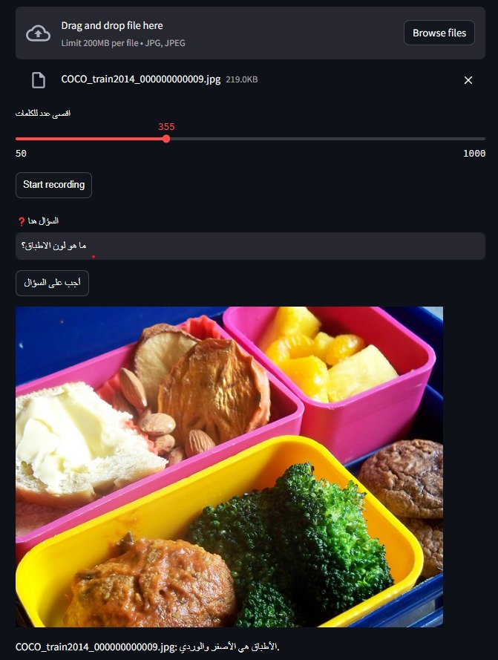
--
Sample of Chat with Image

Slide 27
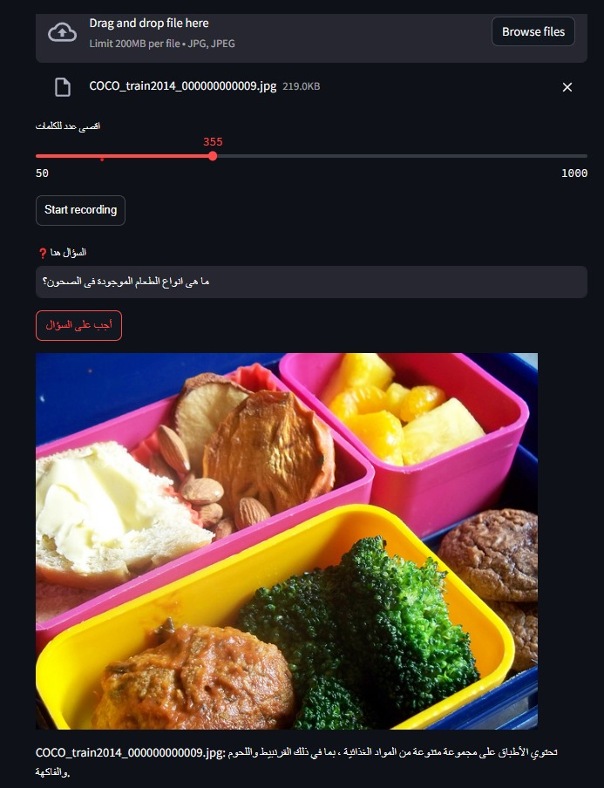
--
Sample of Chat with Image

Slide 28

Deployment with Streamlit
Streamlit is a powerful open-source Python library that allows for the rapid development and deployment of interactive web applications. Its intuitive and user-friendly interface makes it an excellent choice for quickly bringing data-driven projects to life.

Slide 29

Why Streamlit for Deployment?
1
Ease of Use
2
Interactive Widgets
3
Real-time Updates
4
Quick Deployment

Slide 30
Future Work
Enhancing User Experience
Improving Bot Performance
Expanding Knowledge Base
Supporting Multiple Platforms
Adding Interactive Features
User Profiles
Personalized Recommendations
Enhancing Language Accuracy
Improving Response Speed
Adding New Knowledge Sources
Continuous Learning
Integration with Messaging Apps
Developing a Dedicated App
Data Analysis
Adding Advanced Features
Tracking and Analyzing Performance
Regular Reports
Learning from Feedback
Supporting Complex Operations

